Slide 1
WEWATCH -VIDEO DATABASE
Team3 Final Project
-Zhechao Wang, Chris Boschert, Connor Berg, Nasser Alhamadah

Slide 2
PRESENTATION GOALS
ER Diagram
Database Description and Details
Program Introduction
Program Demonstration
Technology and Tools
Future Improvements

Slide 3
ER DIAGRAM

Slide 4
DATABASE DESCRIPTION
We designed a database system called “WeWatch” to store information about movies, television series, and the accounts that use the service.
The service will allow subscribers to view any movie or television series within the database. It will also allow subscribers to manage their favorite movies or television series.
Target users include anyone who enjoys watching movies or TV shows or someone that just wants to learn more about a specific movie or TV show

Slide 5
DATABASE DESCRIPTION
Each account will have an account ID, email address, and password, start date and end date. The account ID will define each individual account. The email address will be the account login username, and the password is just the password. The start date is the date when this account created. And the end date will identify whether this account is expired or not.
A user will have a name associated with it and an ID defining it. Several users may be associated with a single account, but each account must have at least one user.
Each show is defined by a unique ID. It also includes show’s name, homepage, poster and description. A show can be defined as either a movie or a television series. Each movie has a release date and duration. Each television series also has the television channel associated with it. Users will be able to keep track of their favorite shows. And the service will automatically track what each user watched.
Season is a weak-entity set for TV and episodes is a weak-entity set for season. Each season has a year and an season-number defining it. Each episode has an air-date and a name associated with it, it also has an episode-number defining it.
Each actor is defined by a unique ID and has a name associated with him. Each Actor can be in many TV series and many movies. Also, movies and TV series can have many actors.
Each genre is defined by a unique ID and has a name associated with it. For a single movie or TV, there can be several genres.

Slide 6
DATABASE DESCRIPTION - DATABASE SCHEMA
accounts (id, email, password, start, end);
users (id, name, account-id);
history(user-id, show-id, date);
favorites(user-id, date, show-id);
shows(id, name, homepage, poster, homepage, description);
show_genre (show-id, genre-id);
genres(id, name);
movies(show-id, released, duration);
series(show-id, channel);
season(show-id, num, year);
episodes(show-id, season-num, num, air-date, name);
actors(id, name);
show_actor(show-id, actor-id);
User.account-id references Account.id;
WatchHistory.user-id references User.id;
WatchHistory.show-id references Show.id;
FavoriteList.user-id references User.id;
FavoriteList.show-id references Show.id;
Show_Genre.show-id references Show.id;
Show_Genre.genre-id references Genre.id;
Movie.show-id references Show.id;
Series.show-id references Show.id;
Season.show-id references Show.id;
Episodes.show-id references Show.id;
Episodes.season-num references Season.num;
Show_Actor.show-id references Show.id;
Show_Actor.actor-id references Actor.id ;

Slide 7
DATABASE DESCRIPTION - CONCLUSION
We also created two views to help us create a list of recommendations for a specific user. The views are essentially a table of user_ids and genre_ids based off of a user’s watch history and favorite shows. We currently only use the list of a user’s favorite shows to generate a list of recommended shows.
We designed this database for people who like to watch TV shows and movies online as well as allowing people to get more information about a specific show. Additionally, the users would be able to explore other shows that the application recommends for them and hopefully discover a new favorite.

Slide 8
PROGRAM INTRODUCTION
Step 2
Step 3
Step 1
Login account with email address and password.
If you don’t have an account, you can sign up with an email address which is currently not in use.
Search a movie or TV show by key words, or you can use the recommendation to get a movie or TV show you like. Users can also view their list of favorited shows or shows they have watched in the past.
Now you are at the page for a specific movie or TV show, you can see show’s information or you can also watch this show (just a picture right now).

Slide 9
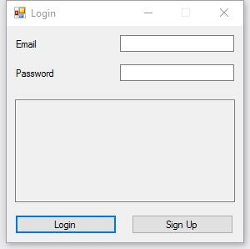
PROGRAM INTRODUCTION – STEP1
Input the email address as your username
Input your password
If you don’t have an account, please
sign up first.

Slide 10
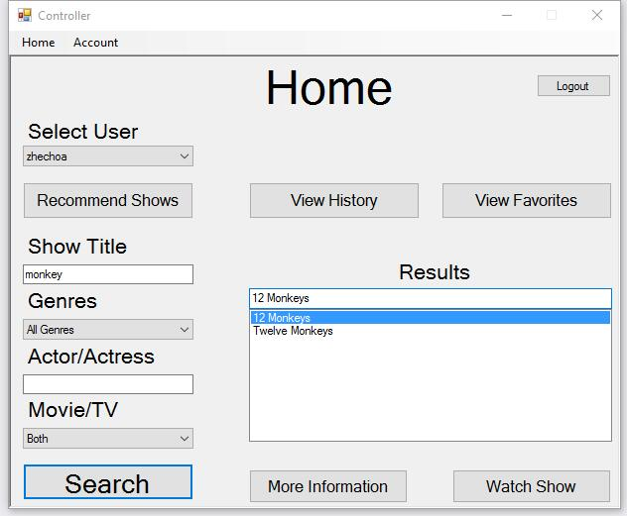
PROGRAM INTRODUCTION – STEP2
You can switch to any user in this account here
Click this you can go to the account page
Click this you will go back to the login page
See what you have been watched
You can get a recommendation if
you have at least one favorite show
Choose or input the searching conditions here, and then click the search button, you will see all shows you need. If all conditions are default, it will return all shows in database.
Check your favorite list
Check more information about the show you chose.
Watch the show you chose, and the service
will also add the show to the user’s watch history.

Slide 11
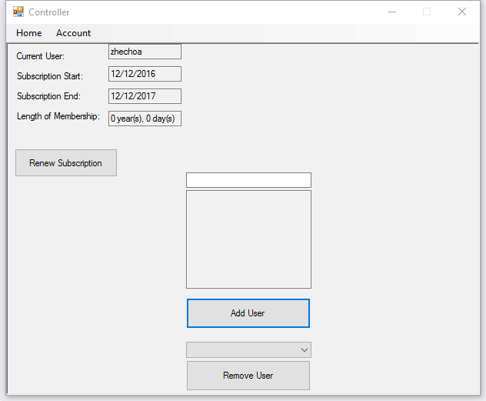
PROGRAM INTRODUCTION – STEP3
This button will renew your subscription
Add new user to this account
You can choose a user above and remove that user by this button

Slide 12
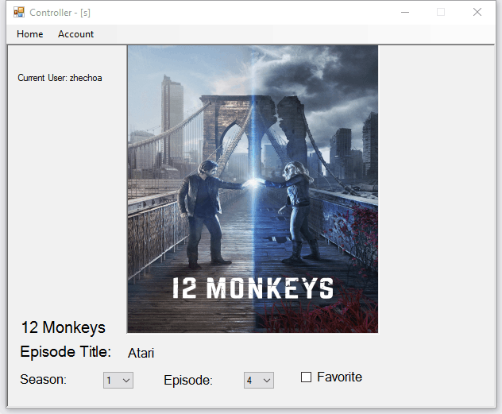
PROGRAM INTRODUCTION – STEP3
Choose which season and episode you want to watch.
You can add this TV show to your favorite list here

Slide 13
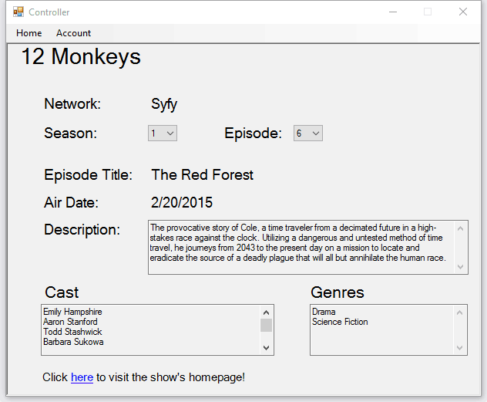
PROGRAM INTRODUCTION – STEP3
Choose a season and episode number here, then the service will display all info about this show.
Use this to go to show’s homepage

Slide 14
Program Demonstration

Slide 15

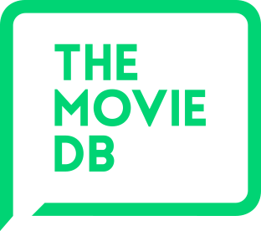


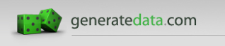
Technology and Tools

Slide 16
Future Improvements
Search:
spelling correction/suggestions
multiple genres and/or actors
refine by release date and network
Recommendations:
watch history
refine by genres and actors
Account /User Management
payment acceptance
Shows:
more information
ability to actually play the show
Interface:
make it look pretty

Slide 17

THE
END
Thanks for watching and listening.
Any questions?

